Slide 1



Slide 2
Index
About Dataset
Project’s Objectives
Exploratory Data Analysis
Benchmark
Optimization
Models Comparison
Conclusion

Slide 3

Amazon Sales Dataset
The Amazon Sales dataset available on Kaggle is a collection of sales data for different products sold on Amazon from 2015 to 2021. The dataset includes information such as the product name, its category, the date and time of sale, the price of the product, the number of units sold and the customer reviews and ratings.
Features(16)
product_id - Product ID
product_name - Name of the Product
category - Category of the Product
discounted_price - Discounted Price of the Product
actual_price - Actual Price of the Product
discount_percentage - Percentage of Discount for the Product
rating - Rating of the Product
rating_count - Number of people who voted for the Amazon rating
about_product - Description about the Product
user_id - ID of the user who wrote review for the Product
user_name - Name of the user who wrote review for the Product
review_id - ID of the user review
review_title - Short review
review_content - Long review
img_link - Image Link of the Product
product_link - Official Website Link of the Product
Inspiration

Slide 4
Objectives
Understand Sales Performance of a particular product or category over time. It allows you to identify the best selling products, the least selling products, and the product categories that are performing well or poorly.
Identify Sales Trends such as seasonality, changes in consumer preferences and the impact of external factors like promotions and discounts. This information can be used to make informed decisions about inventory management and pricing strategies.
Optimize Pricing by providing insights into the pricing strategies, the impact of promotions and discounts on sales and the price elasticity of different products.
Improve Marketing Strategies by identifying the most effective channels for driving sales, the most effective messaging and promotional strategies and the customer segments that are
most responsive to different marketing initiatives.
Forecast Future Sales by analyzing historical sales data and identifying patterns and trends that can be used to make predictions about future sales performance. This information can be used to optimize inventory management, pricing strategies and marketing initiatives.

Slide 5
Questions
Possible insights related to customer behavior and marketing strategies
What are the top-selling categories on Amazon?
Based on the top-selling categories marketing efforts can be focused on promoting products in these categories. Targeted advertising campaigns can be run on social media or other platforms, offer discounts or incentives or partner with influencers to promote these products.
What is the average discount percentage offered on products?
Analyzing the average discount percentage offered on products can help to decide whether the pricing strategy need to be adjusted. If the discount percentage is lower than the industry average,it would be necessary to offer more competitive prices to attract customers.
Are products with higher ratings more likely to be purchased by customers?
Based on the relationship between product ratings and customer purchases, can focus on improving the quality of products and encouraging customers to leave positive reviews. Positive ratings and reviews can increase the credibility and reputation of products, which can lead to more sales.

Slide 6
How many customers are more likely to purchase products with a higher discount percentage?
Based on the relationship between discount percentage and customer purchases,discount strategy can be adjusted to maximize sales. For example, can be offered higher discounts during holidays or special events to attract more customers.
Do customers who purchase more products also rate them more often?
Based on the relationship between the number of products purchased and the frequency of ratings, customers can be encouraged to rate products by offering incentives or reminders. More ratings can lead to more credibility and can help other customers make informed purchase decisions.

Slide 7
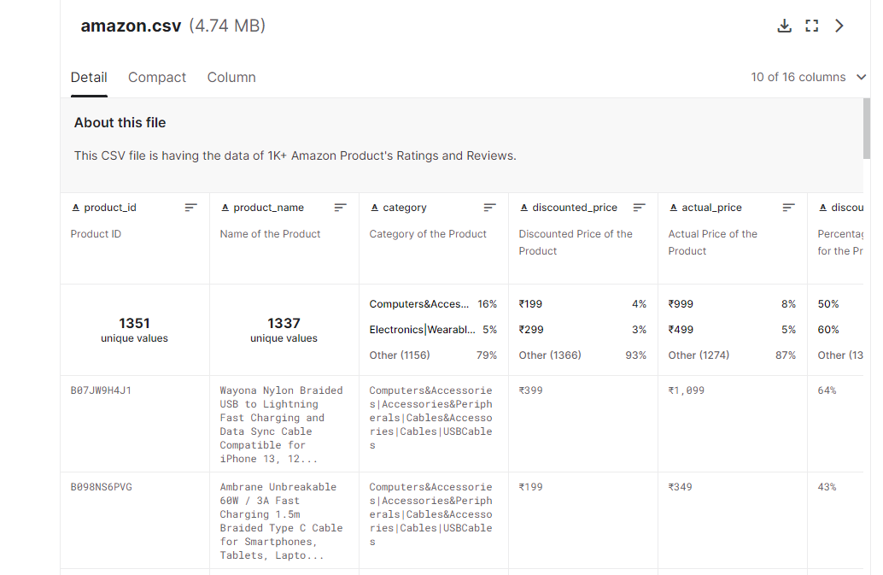
Exploratory Data Analysis

Slide 8
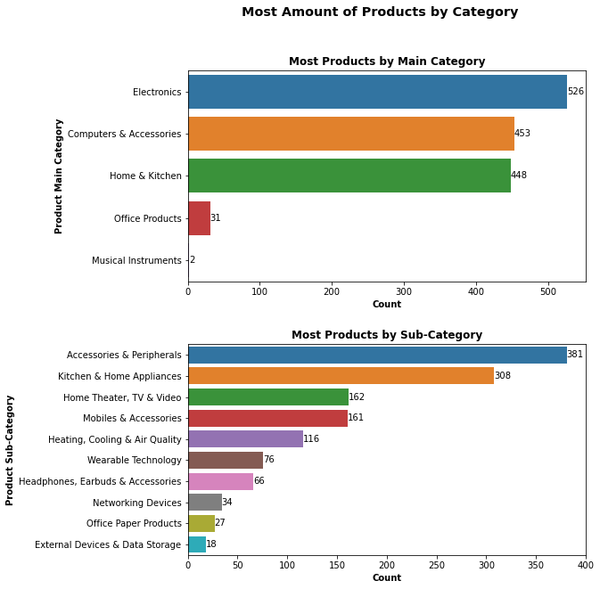
Exploratory Data Analysis
Electronics especially acccessories & peripherals and kitchen & home appliances cover most of the products in this dataset. In general, this dataset contains mostly products closely related to electric devices.

Slide 9
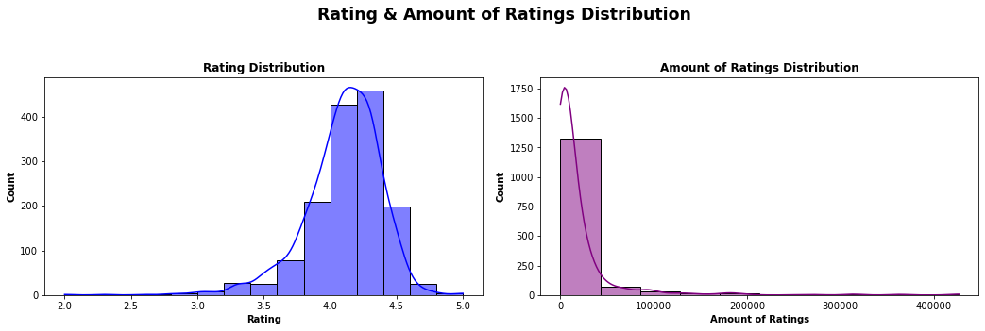
Exploratory Data Analysis
Most of the product rating range around 4.0 - 4.375 with no products under the score of 2.0. The rating distribution in slightly left-skewed.
The number of ratings given to a product is very widespread. Most of the products that have been rated, have around 0 - 5000 ratings for each product. Interestingly there are products that have more than 40,000 ratings. The amount of ratings distribution is highly right skewed.

Slide 10
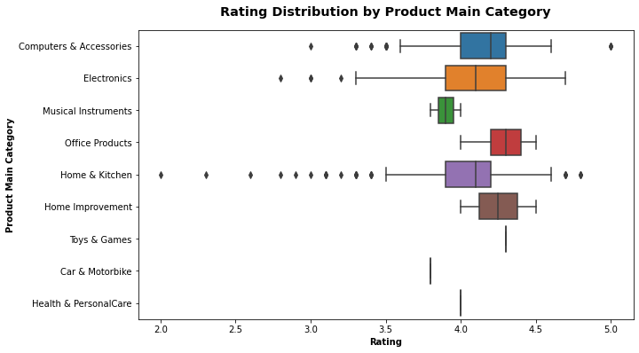
Exploratory Data Analysis
Toys & Games, Car & Motorbike, and Health & Personal Care product ratings's are around 3.75 - 4.375. All Home Improvement, and Office Products have a minimal rating of 4.0.
Many of the Computer & Accessories and Electronics products have ratings in the range of 3.6 - 4.6. Though these categories do have products that have a high rating such as 5.0 and low rating, going down to 2.75.
Noticeably, the Home & Kitchen products have a really widespread rating going to as high as 4.75 and going as low as 2.0 rating, which is the lowest rating out of all the products in this dataset. However, most of the products in this category fall in the range of around 3.8 - 4.6.

Slide 11
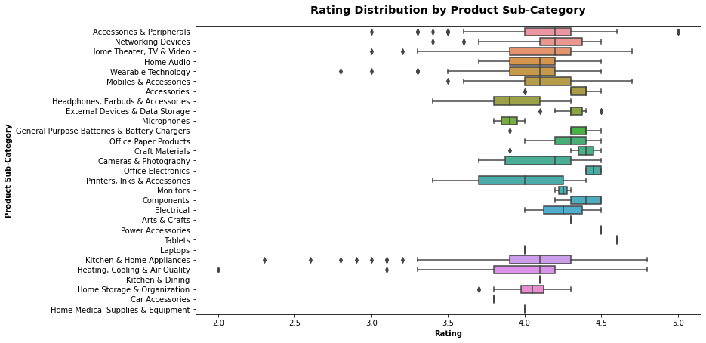
Exploratory Data Analysis
In the Rating Distribution by Product Sub-Category graph, I have noticed that the highest rated product comes from the sub-category of Accessories & Peripherals. The lowest rated product comes from the sub category of Heating, Cooling & Air Quality.

Slide 12
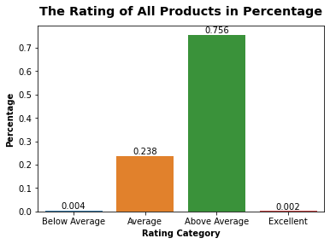
Exploratory Data Analysis
Most of the products in this dataset have been rated Above Average. There are extremely few products that are rated Below Average and Excellent. No products are rated as Poor in this dataset.

Slide 13
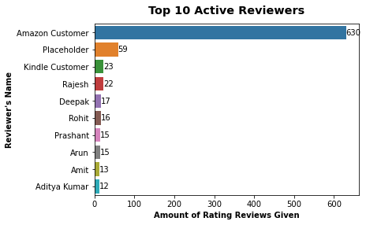
Exploratory Data Analysis
We can see that there are more than 500 people who reviewed a product and give rating anonymously under the alias of Amazon Customer, Place Holder and Kindle Customer.
There are more than 8 people who have given ratings and reviews to more than 10 products on this dataset.

Slide 14
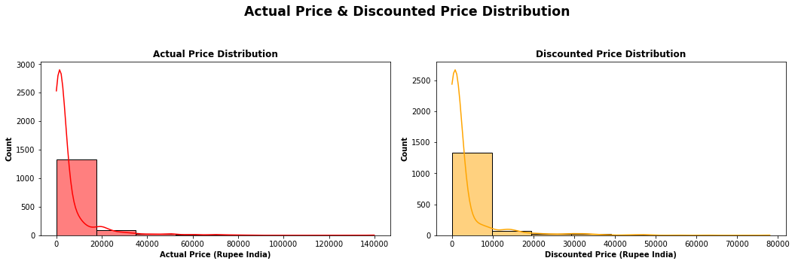
Exploratory Data Analysis
Only the actual prices and the discounted prices of products have a positive correlation. Both graphs show the same distribution which is Right or Positvely Skewed.

Slide 15
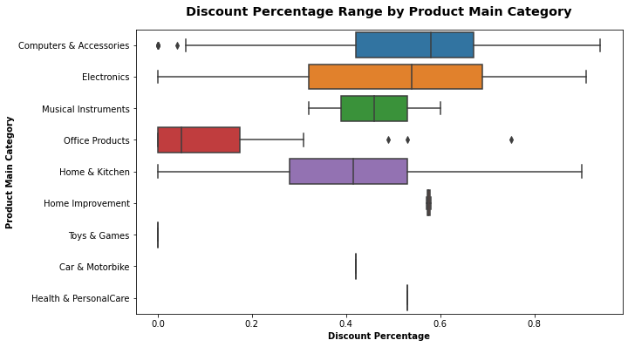
Exploratory Data Analysis
Most products on the dataset have discounts at around 50% - 70%. Computers & Accessories, Electronics and Home & Kitchen products have a large spread of discount variation ranging going up to 90% discount.
Toys & Games, Cars & Motorbikes, Health & Personal Care and Home Improvement have the least spread of discount variation.
Office Products does not give a large amount of discount compared to other products in the Main Category.

Slide 16
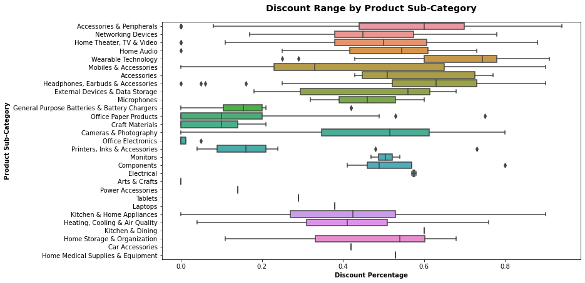
Exploratory Data Analysis
Most products on the dataset have discounts at around 50% - 70%. Computers & Accessories, Electronics and Home & Kitchen products have a large spread of discount variation ranging a minimal of
0 % to more than 90% discount.
Toys & Games, Cars & Motorbikes, Health & Personal Care, and Home Improvement have the least spread of discount variation.
Office Products does not give a large amount of discount compared to other products in the Main Category.

Slide 17
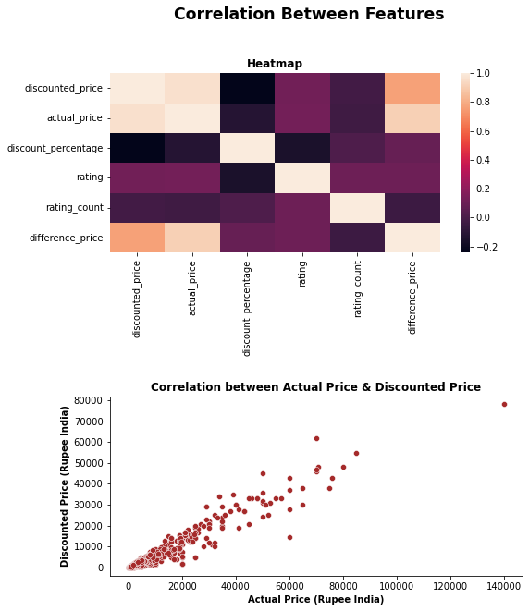
Exploratory Data Analysis
No high multicollinearity
There are almost no correlation between the features in the dataset. Only the actual prices of products and the discounted prices of products have a positive correlation.

Slide 18
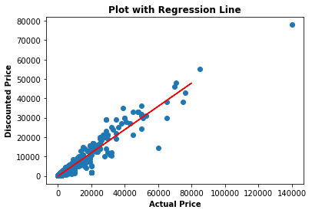
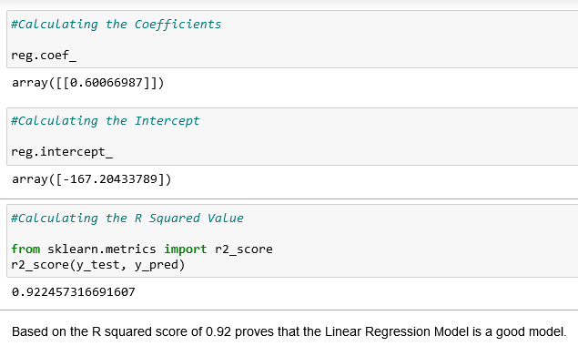
Predicting Discounted Price of Products
The Independent Variable is the Actual Price and the Dependent Variable is Discounted Price.

Slide 19
Thank You!!

